Slide 1
DS5110 Final Project:
MassWeatherHub
Weather Data Integration Pipeline
Rohit Hooda, Rimsha Kayastha, Tri Watanasuparp

Slide 2
TABLE OF CONTENTS
01
02
03
INTRODUCTION
LITERATURE REVIEW
METHODOLOGY
04
05
06
ANALYSIS & RESULTS
DISCUSSION
CONCLUSION

Slide 3
01
Introduction
Objectives and Goals

Slide 4
Objectives & Goals
Develop data integration pipeline combining data from APIs, historical datasets, shapefiles, and CSVs
Create dashboard offering a comprehensive view of weather trends
Ensure data is clean, accurate, and analysis ready
Deliver interactive visualizations for interpreting weather data

Slide 5
Project Scope
Geographical focus: Massachusetts counties
Date range: Historical (January 1, 2022– Oct 30, 2024), real-time, and 7-day forecast data

Slide 6
Key Data Sources
Open-Meteo API: This API is primarily used for retrieving weather forecast data.
OpenWeatherMap API: This API is used to access historical weather data.
NOAA Weather Data API: The National Oceanic and Atmospheric Administration (NOAA) provides a wealth of weather datasets with numerous attributes.
MassGIS Shapefiles: These files provide geographical data for Massachusetts counties, allowing for the visualization and analysis of weather data in a spatial context.

Slide 7
Project Overview
MassWeatherHub is a weather data integration pipeline that combines data from various sources to provide a comprehensive view of weather trends in Massachusetts.

Slide 8
02
LITERATURE REVIEW
Summary and Relation to Relevant Work

Slide 9
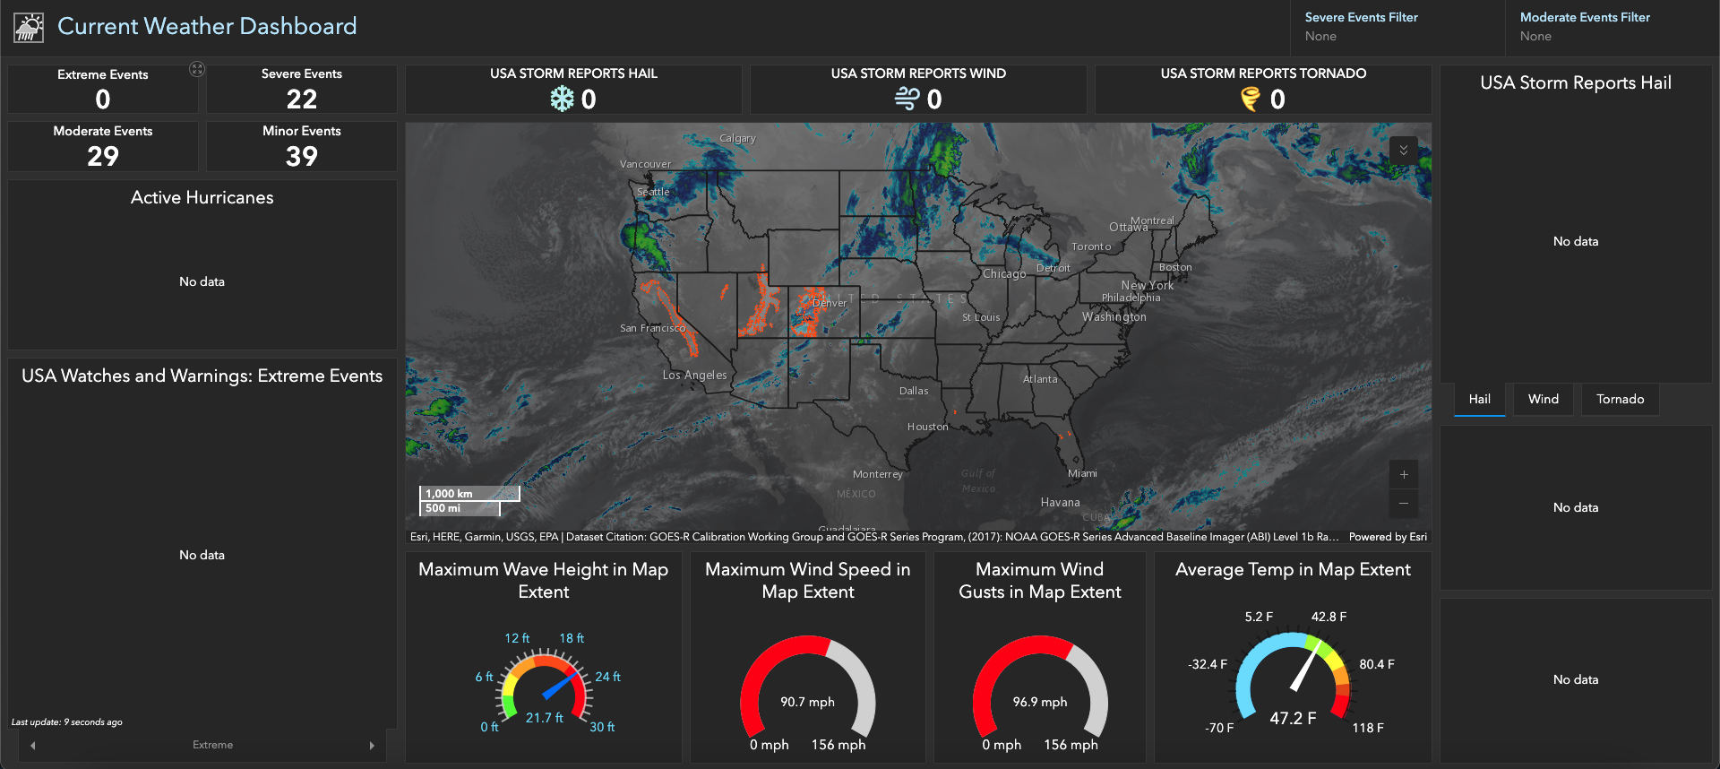
Arcgis Dashboard
The ArcGIS Weather Dashboard provides real-time U.S. weather alerts, including storms, heat waves, and hurricanes, through an interactive map.
Notes:
Remember to add what they lack

Slide 10
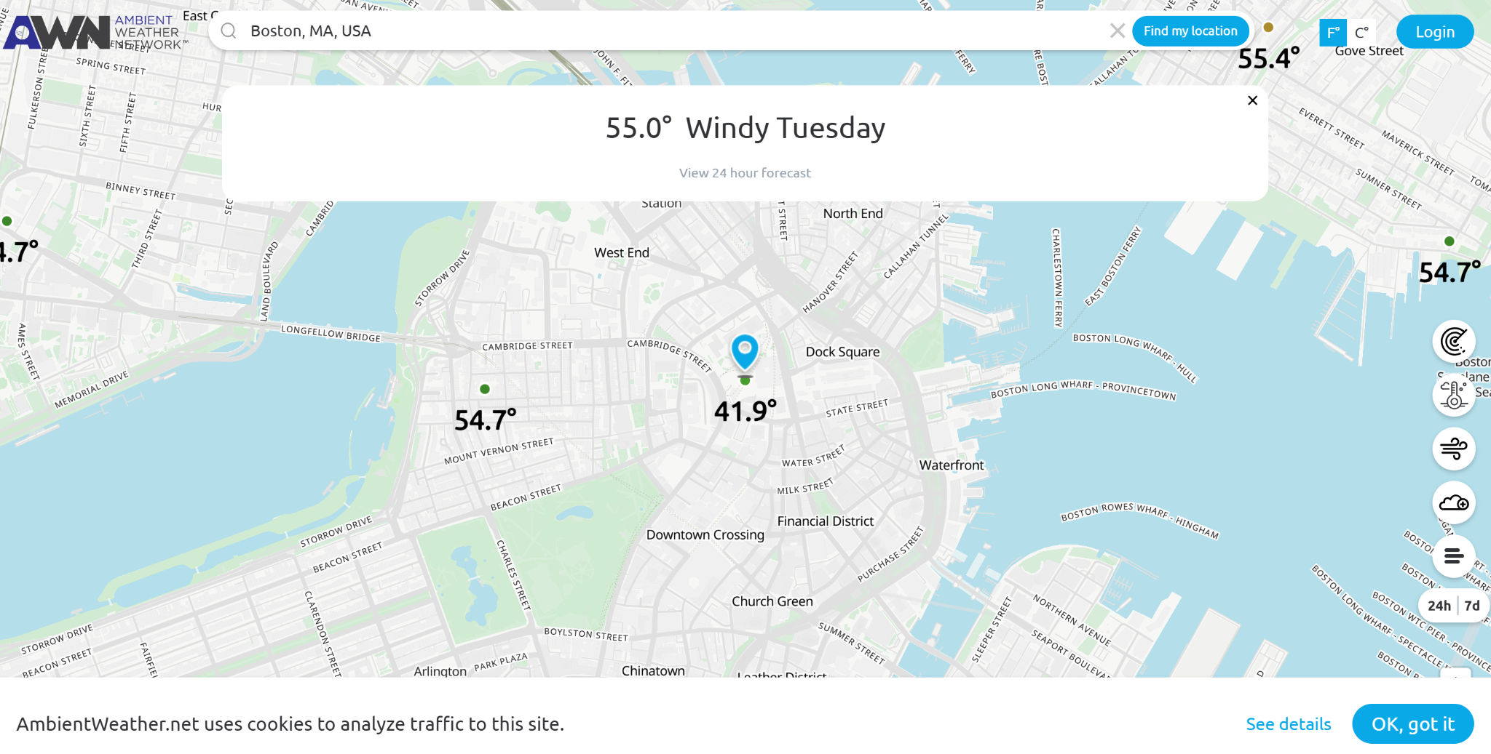
Ambient Weather Dashboard
The Ambient Weather Dashboard delivers hyper-local, real-time weather data from personal weather stations, tracking metrics like temperature, humidity, wind speed, and rainfall.
Notes:
Remember to add what it lacks

Slide 11
03
METHODOLOGY
Methods and Techniques Used

Slide 12
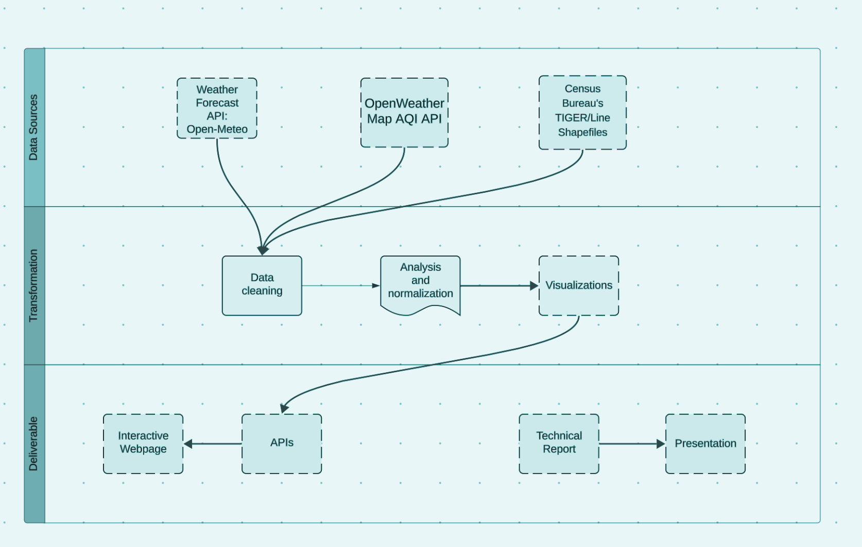
Data extraction from Open-Meteo API, OpenWeather API, and MassGIS shapefiles
Transformation: Cleaning, normalization, and geospatial alignment
Deliverables: Integration pipeline to merge datasets into unified, readable formats

Slide 13
04
DATA ANALYSIS & RESULTS
Key Findings and Insights

Slide 14
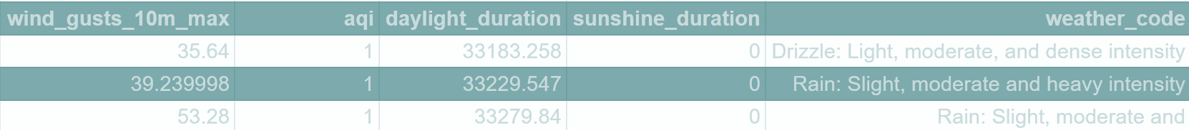
Selected Attributes
Date
County (name)
Latitude/longitude
Temperature (min/max)
Humidity
Wind Speed
Wind Gust
Weather Code
UV Index
Sunrise/Sunset
MA Counties Shapefiles
Air Quality Index

Slide 15
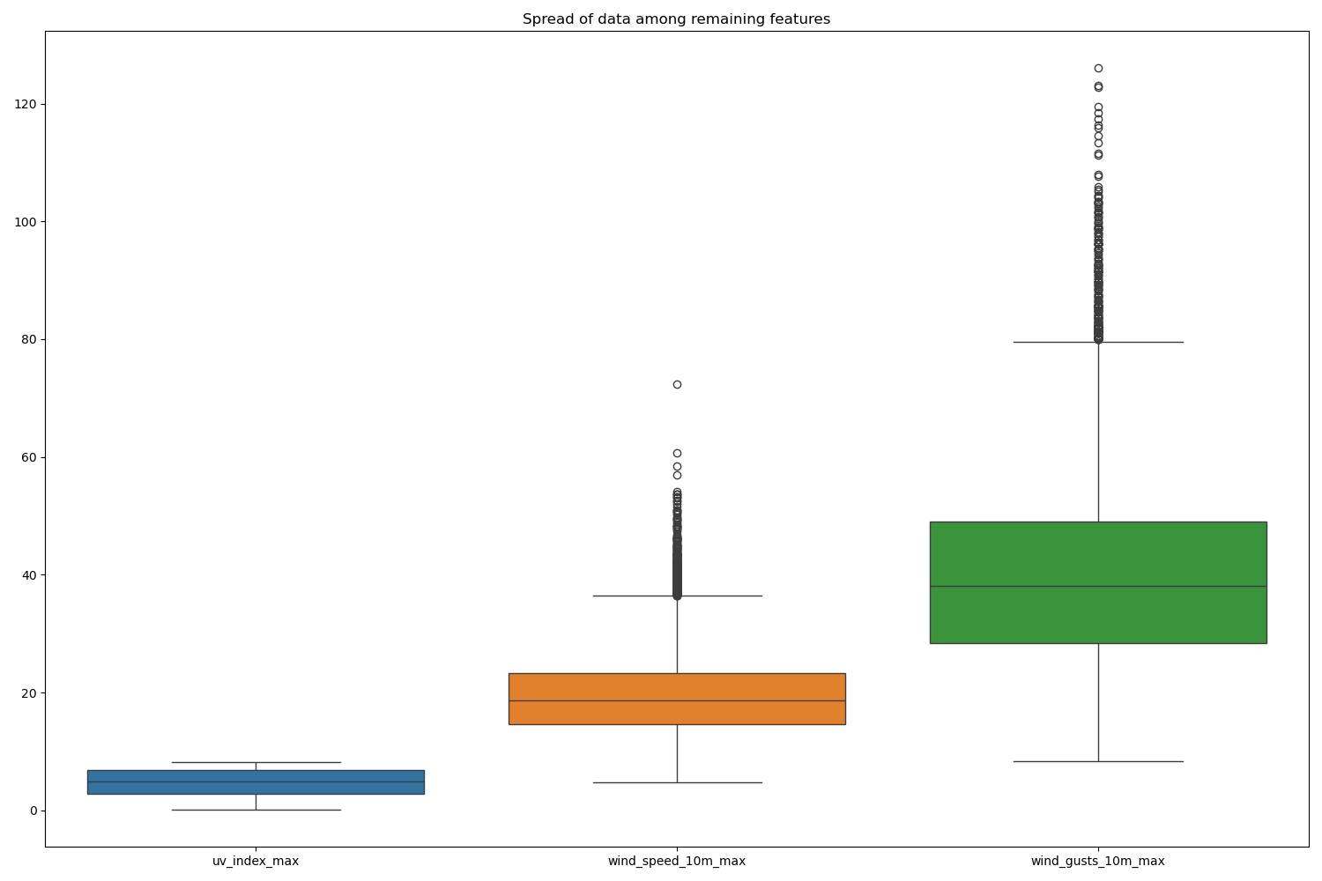
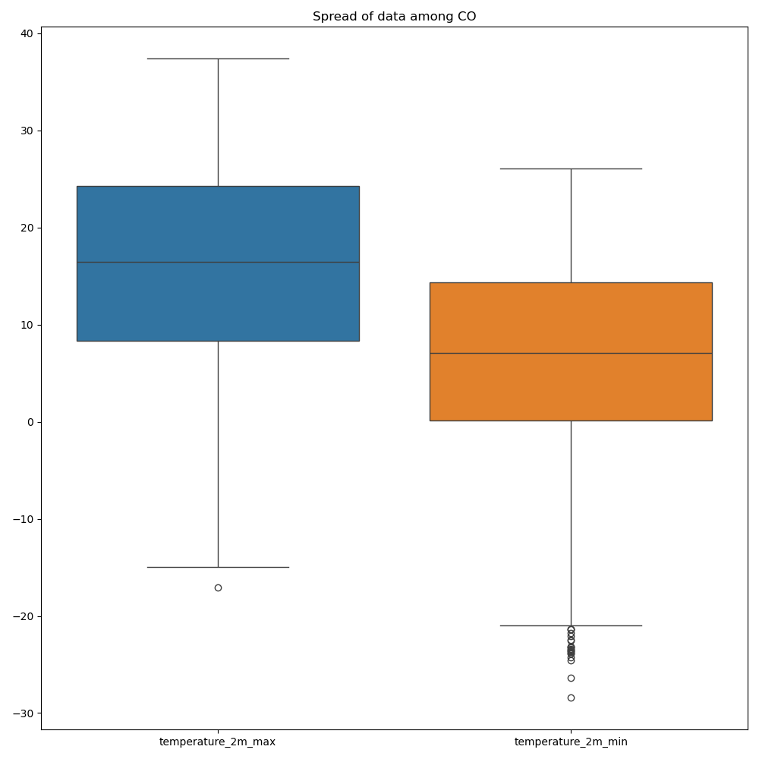
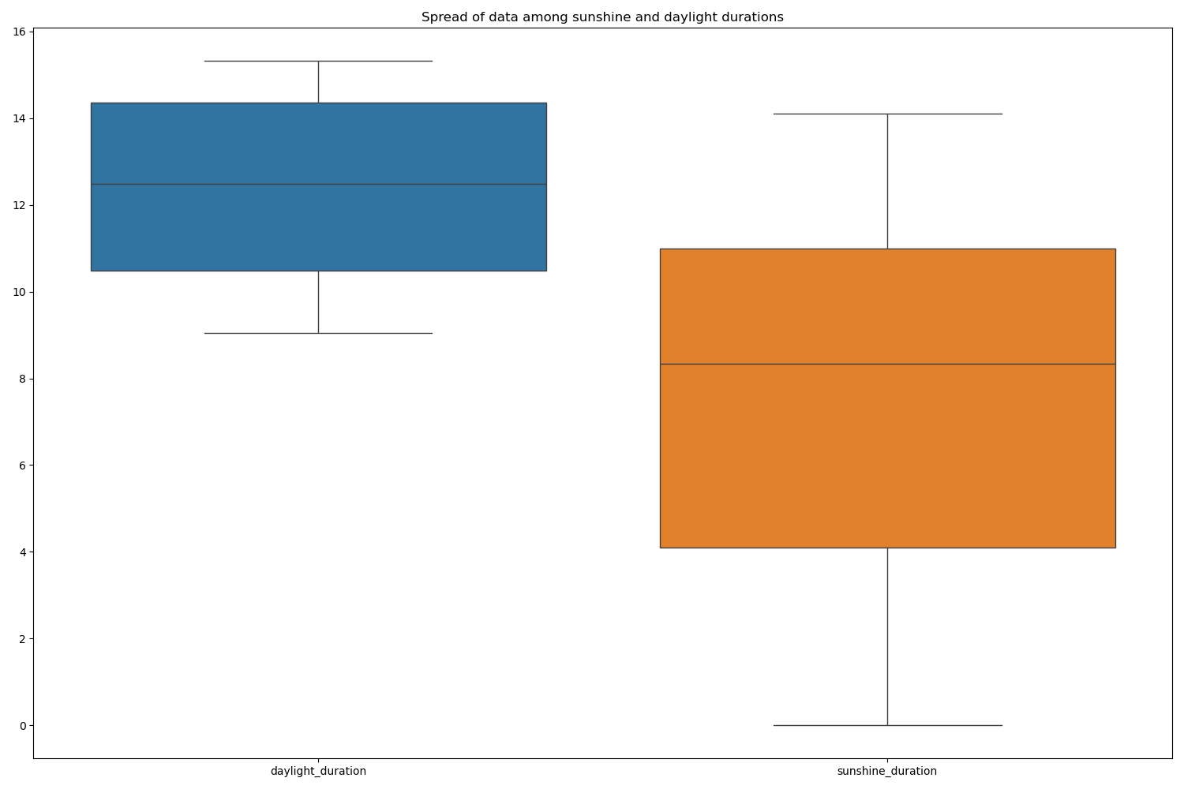
Data Cleaning
Outliers
Scaling

Slide 16
DEMO TIME!

Slide 17
05
DISCUSSION
Implications of Findings,
Project Limitations

Slide 18
Project Limitations
Only a few reliable data sources for weather
Limited Historical Data (Jan. 1, 2022 to Oct. 30, 2024)
Only information available for Massachusetts counties
Open-Meteo and OpenWeatherMap APIs have rate limits, potentially restricting the amount of data that can be retrieve
(***Implications of Findings: Discussed during the Demo)

Slide 19
CONCLUSION
06
Conclusions and Recommendations for Future Work

Slide 20
Future Work
Expand coverage to all U.S. states, increasing applicability and impact
Integrate additional data sources and features, enriching the insights derived from the data
Enable data retrieval via user’s current location, providing a more personalized experience
Host the website on the cloud to improve accessibility and scalability
Integrate email subscription for weather alerts

Slide 21
07
REFERENCES
Sources

Slide 22
Sources
Open-Meteo API
NOAA (2023). Weather Data API Documentation.
OpenWeatherMap (2024). Historical Data Overview.
MassGIS Shapefiles

Slide 23
Thank you for listening!
Any Questions?

